Slide 1
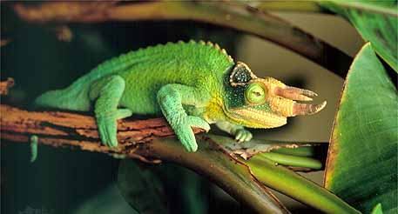
CLASS REPTILIA
By Beatriz Thames, Danielle Andersen, Luis Flores, and Evan Barber

Slide 2
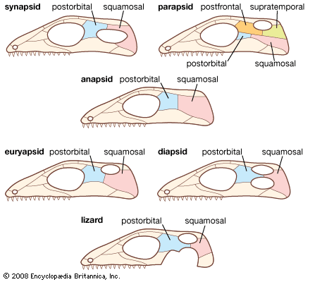
INTRODUCTION &
CLASSIFICATION
Kingdom: Animalia
Phylum: Chordata
Subphylum: Vertebrata
Class : Reptilia
What is a Reptile?
vertebrate
dry, scaly skin (keratinous epidermal scales)
lungs
terrestrial eggs with several membranes
Other Characteristics
Air-breathing
well-developed skull
a backbone and tail

Slide 3
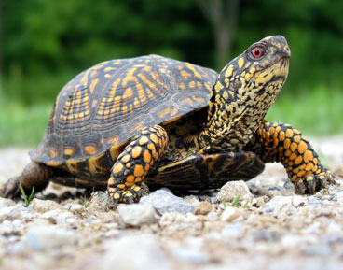
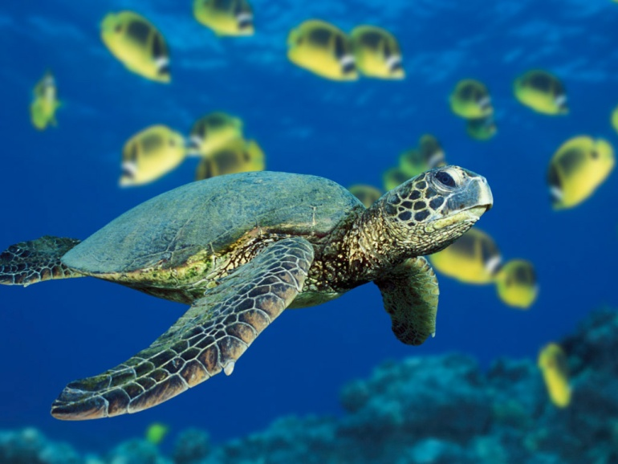
Order Testudines (tes-TOO-dih-neez)
or Chelonia
Includes: Turtles – live in water
Tortoises – live on land
Terrapins – turtle that lives in semi salty water
Time Period : Upper Triassic to present
Size: Small (16 cm [6 inches]) to large (3.6 meters [12 feet] in shell length)
Characteristics:
shell built into the skeleton
- carapace: dorsal part with the animal’s backbone as the center
- plastron: ventral part
- head, legs, and tail stick out through holes where the carapace and plastron join.
- Lack teeth (horny ridges that cover the upper and lower jaws)

Slide 4
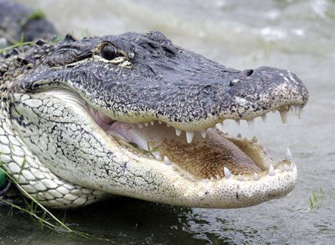
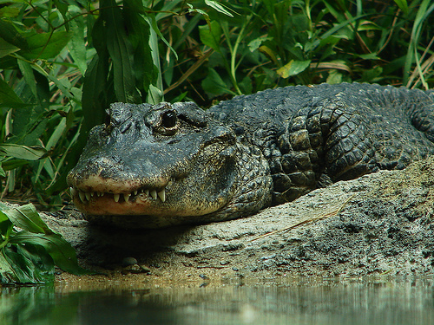
Order Crocodilia
Includes: Alligators – freshwater only, found in N & S America
Crocodiles – both fresh & salt water, native to Africa, India, & SE Asia
Caimans – freshwater only, found in N & S America
Gavials
Size: 1.5 to about 7 meters (5 to 23 feet)
Time Period: Paleocene to present.
Characteristics:
Aquatic or amphibious reptiles

Slide 5
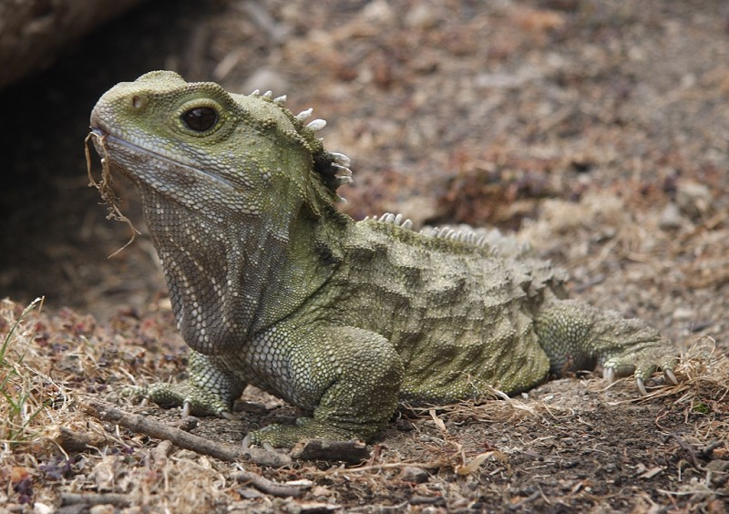
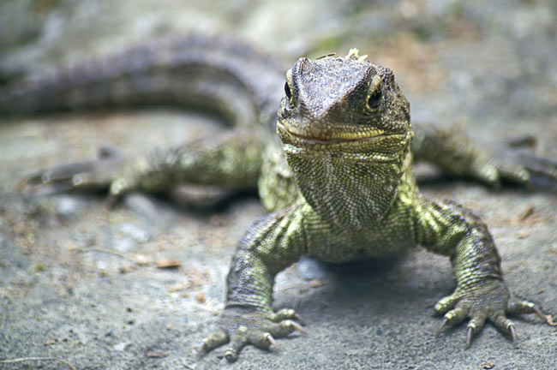
Order Sphenodonta (sfen-uh-DONT-uh)
or Rhynchocephalia
Includes: tuatara – only surviving member of its order, found only on a few small islands off the coast of New Zealand.
Size: 2-3 feet long
Time Period: Lower Triassic to present.
Characteristics: resemble lizards
Differ by:
lack external ears
retain primitive scales
legendary “third eye,” - complex organ on top of the brain that senses the level of sunlight

Slide 6
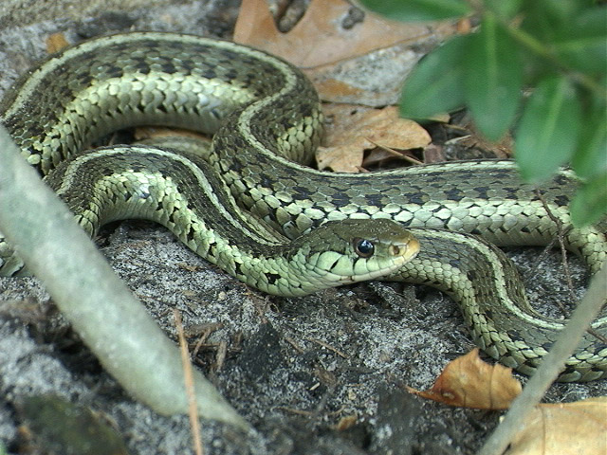
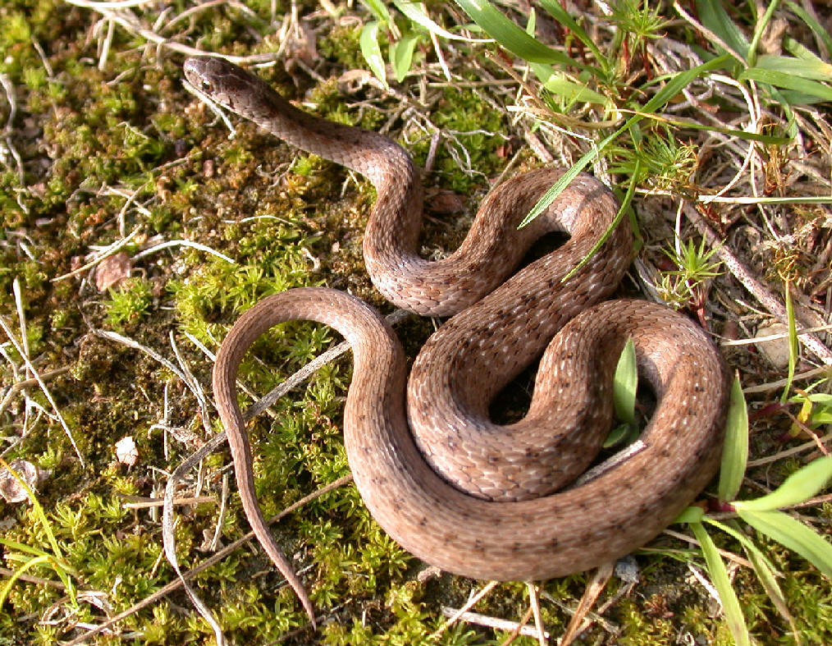
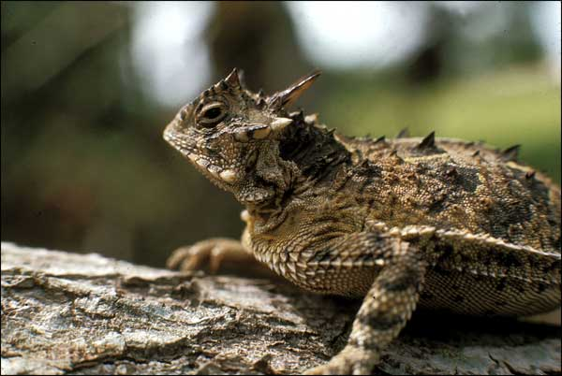
Order Squamata (skwa-MAH-tuh)
Characteristics, Size, & Includes:
Lizards - legs, clawed toes, external ears, and movable eyelids
Snakes – size range from earthworm to 8 meters
Time Period: Upper Jurassic to present

Slide 7
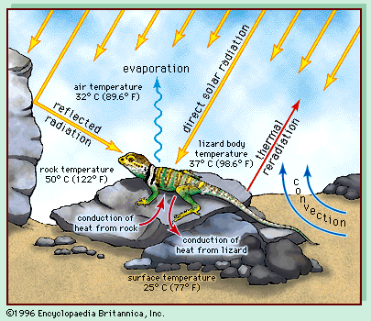
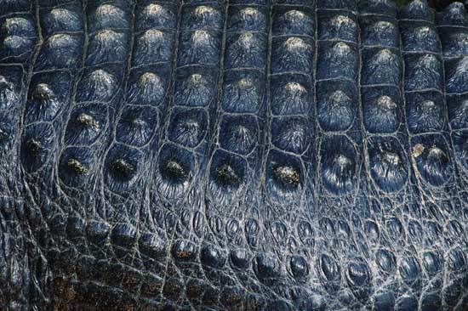
BODY COVERING
& TEMPERATURE REGULATION
ectothermic - require an external heat source to elevate their body temperature (strongly dependent on surrounding temperatures because they’re cold-blooded)
preferred body temperatures above 28 °C (82 °F), maintained by shuttling in and out of sunlight.
dry, scaly skin (keratinous epidermal scales)

Slide 8
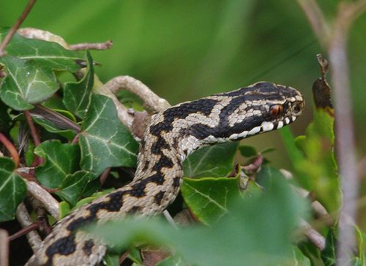
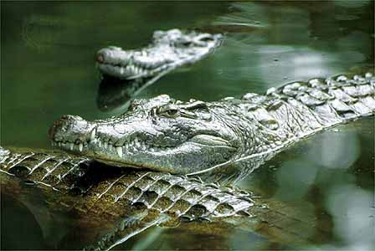

HABITAT
Temperate & Tropical regions mostly between 30° N & 30° S latitude | Reptiles
Estuaries, coral reefs, open sea | Sea Snakes, Sea Turtles
Freshwater rivers, lakes, mountain streams | Many snakes, crocodiles, few lizards
Forests | Turtles, Snakes, Lizards
Grasslands | Turtles, Snakes, Lizards
Deserts | Turtles, Snakes, Lizards

Slide 9
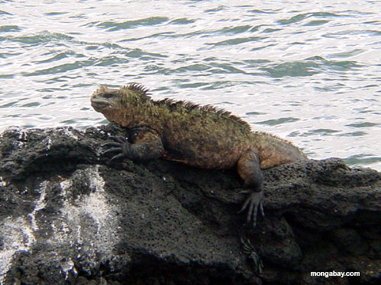
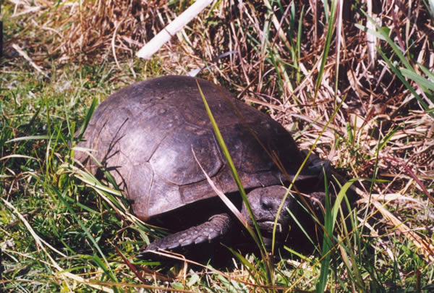
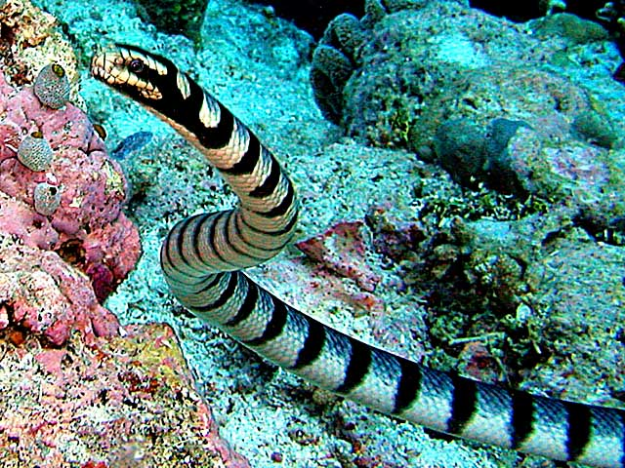
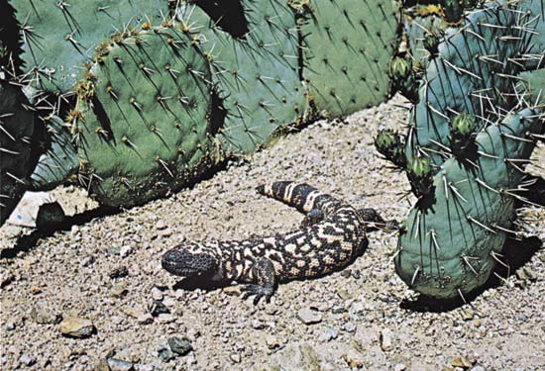

Slide 10
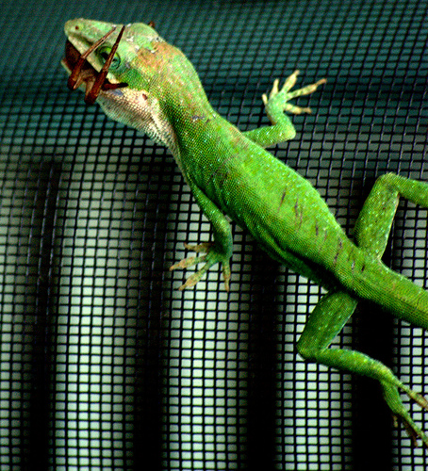
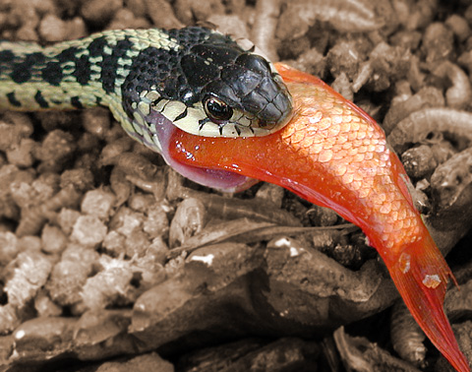
Diet
Most:
feed on insects
also eat mollusks, birds, frogs,mammals, fishes, other reptiles
have no specialized diets and feed on a variety of animals
the smaller the reptile, the smaller is its prey.
Examples:
Marine iguana: seaweed
Chameleon: insects
Snake: small mammals, bird eggs, other snakes
Crocodile: fish, land mammals
Tortoise: herbivores
Tuatara: insects, invertebrates, lizards, eggs, baby birds, smaller tuataras.

Slide 11
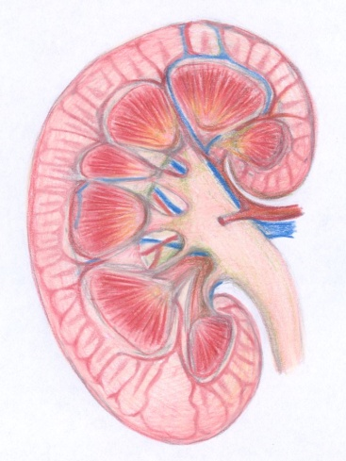

EXCRETORY SYSTEM
Urine produced in the kidneys & flows
-to urinary bladder to store urine and then to cloaca similar to amphibians
Cloaca: common chamber and outlet into which the intestinal, urinary, and genital tracts open (means “sewer” in Latin)
Urine contains
-ammonia: toxic compound excreted by animals that live mainly in water (crocodiles, alligators). They drink a large amount of water to dilute the ammonia in the urine and helps carry it away.
or
-uric acid: convert ammonia to uric acid (much less toxic than ammonia, no diluting necessary) excess water is absorbed and conserved in the cloaca, reducing urine to crystals of uric acid that form a pasty white solid.

Slide 12
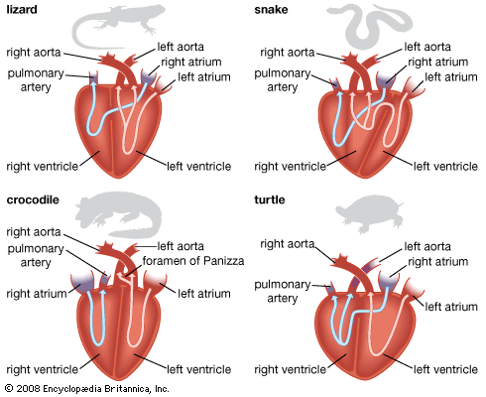
Don’t have the capacity for the rapid sustained activity found in birds and mammals
completely divided atrium
ventricle is at least partially divided.
CIRCULATORYSYSTEM
efficient double-loop circulatory system
One of the loops brings blood to and from the lungs
other loop brings blood to and from the rest of the body
2 atria and 1 ventricles
ventricle with a partial septum, or wall, helps separate oxygen-rich and oxygen-poor blood during the pumping cycle.
Crocodiles and Alligators
most developed hearts of living reptiles. The heart consists of 2 atria and 2 ventricles—an arrangement that is also found in birds and mammals.

Slide 13
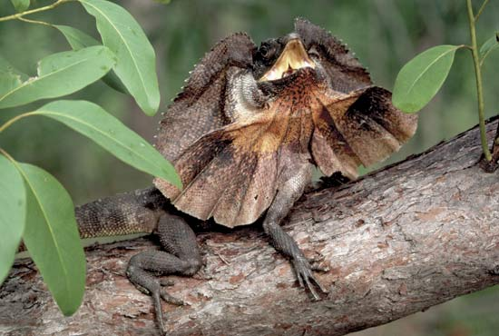
RESPIRATORY SYSTEM
All: spongy lungs provide more gas exchange than amphibians
Most:
Rate of Respiration: Irregular breathing patterns of active of inhaling & exhaling w/ relatively long pauses depending on the temperature of the environment & on the animals emotional state
can hold breath an hour or more in some turtles & aquatic snakes during diving
All except for turtles breathe by changing the volume of the body cavity
contractions of the muscles moving the ribs, the volume of the body cavity is increased
this creates a negative pressure
Negative pressures restored to atmospheric level by air rushing into the lungs.
contraction of body muscles, the volume of the body cavity is reduced, forcing air out of the lungs.
2 lungs

Slide 14
Snakes: lungs are simple saclike structures with alveoli in the walls.
Some species have one lung
Crocodiles (many lizards and turtles): surface area is increased by the development of partitions that have alveoli.
Exchange of respiratory gases takes place across surfaces
increase of the ratio of surface area to volume = increase in respiratory efficiency
Some crocodiles: flaps of skin that can separate the mouth from the nasal passages, allowing to breathe through nostrils while their mouth remains open.
Turtles: fusion of the ribs with a rigid shell = no volume change of body cavity
use the same mechanical principle of changing pressure in the body cavity
Contraction of 2 flank muscles enlarges the body cavity = inhale
Contraction of 2 other muscles relaxation of the first 2 forces the viscera upward against the lungs = exhale

Slide 15
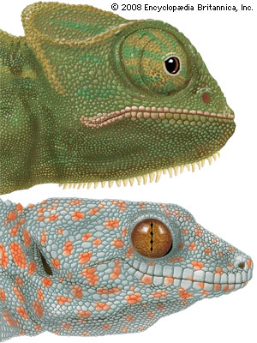
Nervous System
olfactory bulb (regulating the sense of smell) in caiman and crocs
cerebrum and cerebellum are considerably larger compared to the rest of the brain.
complex eyes and can see color well.
all vertebrates:
brain,
spinal nerve cord
nerves running from the brain or spinal cord
sense organs
cerebral hemispheres -principal associative centers of the brain: relative absolute size of much smaller than mammals
external eardrum and a single bone that conducts sound to the inner ear
Snake’s & alligator’s brain forms less than¹/_{1,500} of total body weight, whereas in mammals about ¹/₁₀₀ of body weight.
Many snakes: Jacobson’s organ- extremely good sense of smell the roof of the mouth that can detect chemicals when the reptiles flick their tongues
Pit organ-detect the body heat of their prey.
pick up vibrations in the ground through bones in their skulls

Slide 16
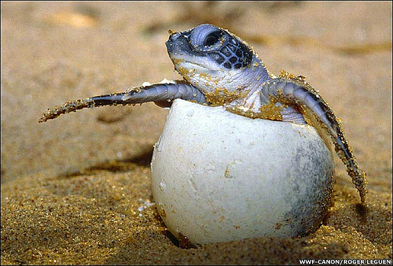
REPRODUCTIVE SYSTEM
internal fertilization - male deposits sperm inside the body of the female through the cloaca.
Most oviparous - laying eggs that develop outside the mother's body.
Some snakes and lizards are ovoviviparous - carries her eggs within her body for egg protection & warmth & young are born alive
Egg:
After fertilization covers the embryos with several membranes and a leathery shell to create a protected environment in which the embryo can develop without drying out called an amniotic egg & it was important to the adaptations to life on land.

Slide 17
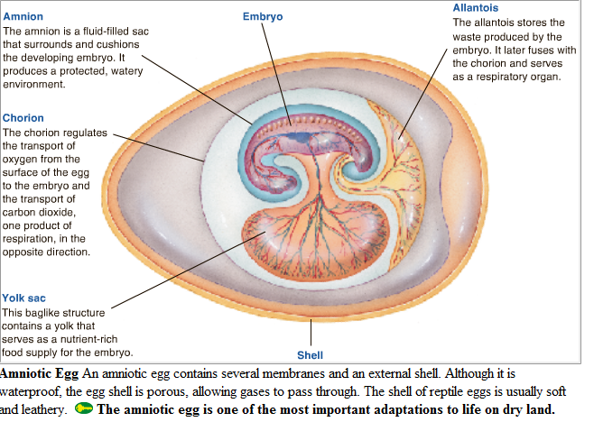

Slide 18
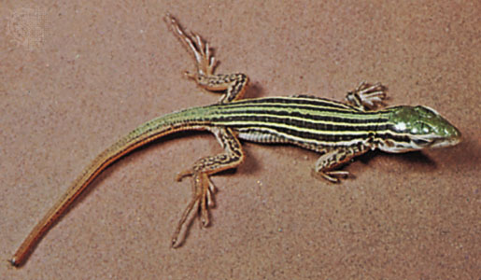
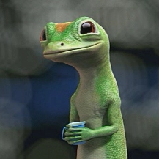
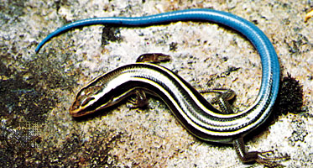
GOOD LINKS AND SOURCES
Sources:
www.britannica.com
Biology Textbook
Links:
http://www.school.eb.com/eb/art-16546/Marine-iguanas-of-the-Galapagos-Islands
http://www.school.eb.com/eb/art-97551/Audio-clip-of-a-rattlesnake

